Slide 1
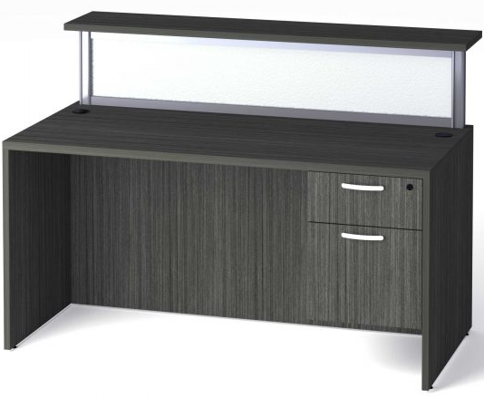
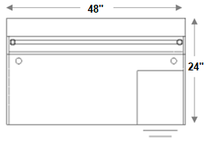
IN-STOCK &
READY TO DELIVERY
48” x 24” BOARDERS RECEPTION DESK WITH BF PEDESTALS
KEY FEATURES
Worksurfaces are 1-3/16” with durable 3mm edges
Wood & aluminum frame glass hutch door options
Ball-bearing drawer slides
Six laminate finishes
Satin nickel pulls
Limited lifetime warranty
SPECIFICATIONS
Overall Width | 48"
Overall Depth | 24"
Counter Height | 42"
TL-4824 | 48" x 24" Desk Shell
TL-BF1518LOCK | Box/File Pedestal
PBP12-SIL | (2) 12" Post
PB21248ACR | 48" Frosted Screen
PBT48 | 48" Transaction Top
SHOWROOM LOCATIONS
POMPANO – FT LAUDERDALE 2099 W. Atlantic Blvd. Pompano Beach, FL 33069 info@ofwfl.com 954-968-4700
MIAMI - DORAL 3411 NW 72nd Ave. Miami, FL 33122 info@ofwfl.com 305-266-4447

